Slide 1

Quality Maintenance Pillar
Awareness Training Programme

Slide 2
Quality Maintenance
(Hinshitsu Hozen)

Slide 3
Background – QM Pillar
No structured approach
to analyze defects
Defects were high
for survival
Background
No customer
satisfaction
No sustained efforts
For defect prevention
Process condition are
not standardized
High process
variation

Slide 4
Why Quality
Survival
Globalization
Zero
Defect
Quality
Competition
Customer
Satisfaction
Customer
Demand

Slide 5
Aim – QM Pillar
To overcome the deficiency in Quality Assurance system & to produce defect free product at a reduced Quality cost.

Slide 6
Target – QM Pillar
Sr. no | Parameters | Unit | Benchmark | Target
1 | Customer complaint | PPM
2 | Warranty Rejection | PPM
3 | In process Rejection /Scrap | PPM
4 | In process Rework | PPM

Slide 7
QM Master Plan
Master plan for Quality Maintenance is planning of various activities in this pillar with respect to the time frame in months and years. According to the stage of TPM implementation it can start at various levels. In the beginning it will start with data collection on defects to improving conditions to sustaining zero defect conditions.

Slide 8
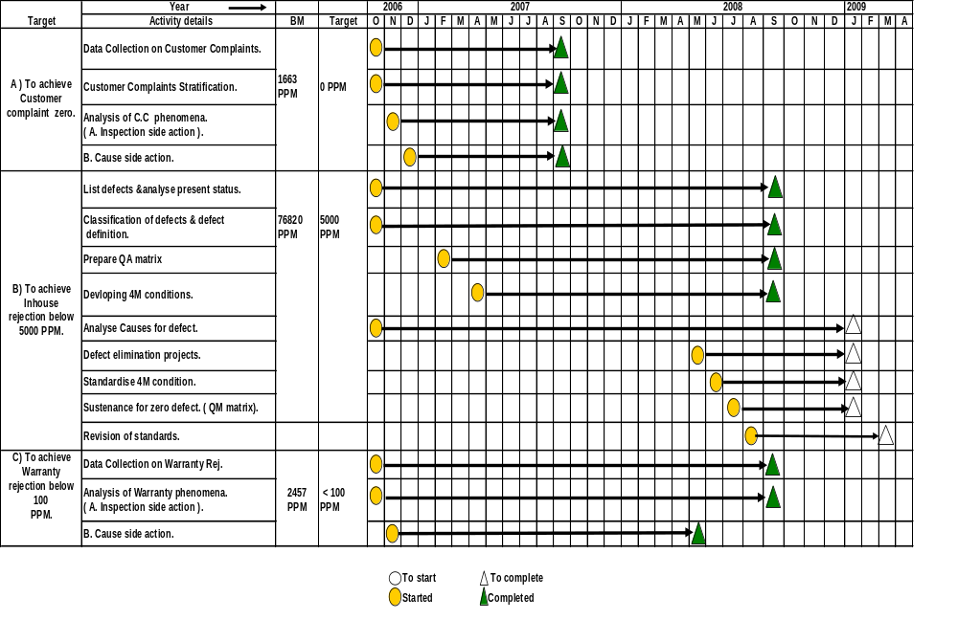
QM Master Plan

Slide 9
10 Steps of Quality Maintenance
Verify present status
Survey of process which generated defect
Survey and analysis of 4M conditions
Study of malfunction countermeasures
Analysis of conditions for non-defective units that are not confirmed
Improve 4M condition defects
Setting 4M conditions
Intensification and improvement of check methods
Deciding check reference value
Standard revision and trend control

Slide 10
Step-1 – Verify present status
Data Collection on defects
Identify total no. of defect phenomena
Shop /Cell wise stratification
Preparation of Defect matrix
Selecting component for further study based on priority
Study the component drawing for inspection & inspection standard availability

Slide 11
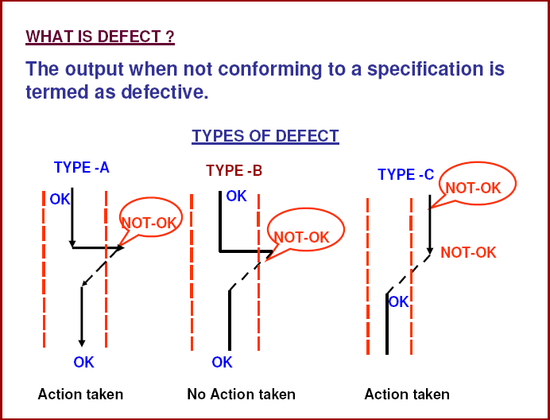
Defect Classification

Slide 12
Defect Classification
‘A’ TYPE DEFECT
Limit of output
specification
OK
The output is (OK ) initially
Becomes Not ok
Corrective action action by operator
Becomes OK
NOT-OK
Action taken by Operator
Root causes analysis Tool
LSL
OK
USL
Why Why Analysis

Slide 13
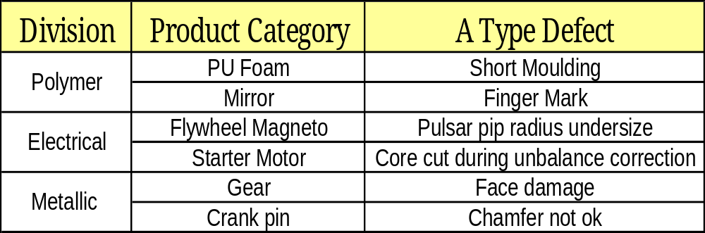
A type Defect - Examples

Slide 14
Defect Classification
‘B’ TYPE DEFECT
Limit of output
specification
OK
The output is (OK ) initially
Becomes Not ok
NO action taken by operator
Becomes OK
NOT-OK
No Action by operator
Root causes analysis Tool
LSL
OK
PM Analysis or
C & E Diagram
USL

Slide 15
B type Defect - Examples
Division | Product Category | B Type Defect
Polymer | PU Foam | Foam uneven feel
 | Extrusion | Black spot
Electrical | Flywheel Magneto | Rotor case damage
 | Flywheel Magneto | Dent mark on taper
Metallic | Gear | Bore ovality
 | Crank pin | Pitting mark

Slide 16
Defect Classification
‘C’ TYPE DEFECT
Limit of output
specification
Not OK
The output is (Not OK ) initially
Action taken by operator
Becomes OK (Setting scrap)
OK
Action by taken operator
Root causes analysis Tool
LSL
USL
Why ,Why Analysis or
C & E Diagram
OK

Slide 17
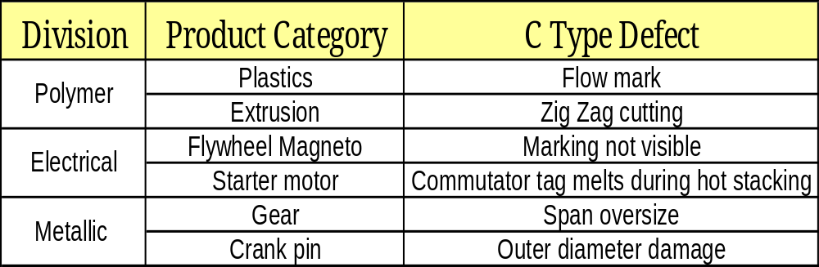
C type Defect - Examples

Slide 18
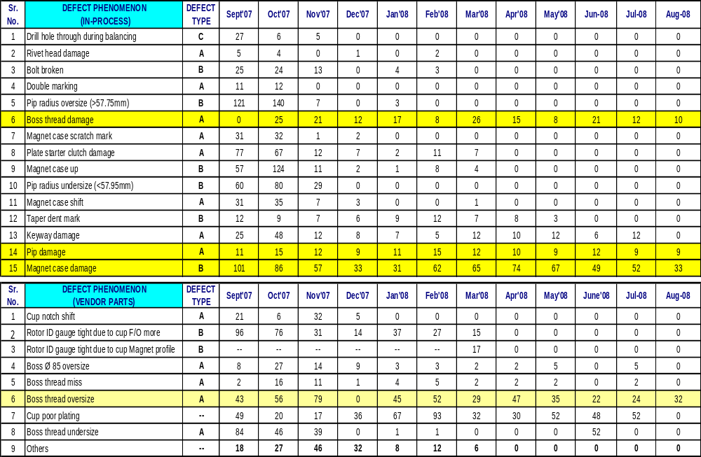
PHENOMENA WISE MONTHLY REJECTION QUANTITY MATRIX ROTOR ASSEMBLY

Slide 19
Step-2 – Survey of process which generated defect
Study of possible and happened defect phenomena in past for similar component.
QA Matrix for quality characteristics based on process survey (Possibility)
QA Matrix updation based on defects occurred

Slide 20
Prepare Quality Assurance matrix & reflection in standards
QA Matrix – QA (Quality Assurance) Matrix is used to find out sources of defects in product. QA matrix shows the relation ship between defect/defect mode & the process which causes it. It requires data collection for defects at various process stages to prepare a QA Matrix. Hence QA matrix is to be made quality defect wise, process wise and machine wise.

Slide 21
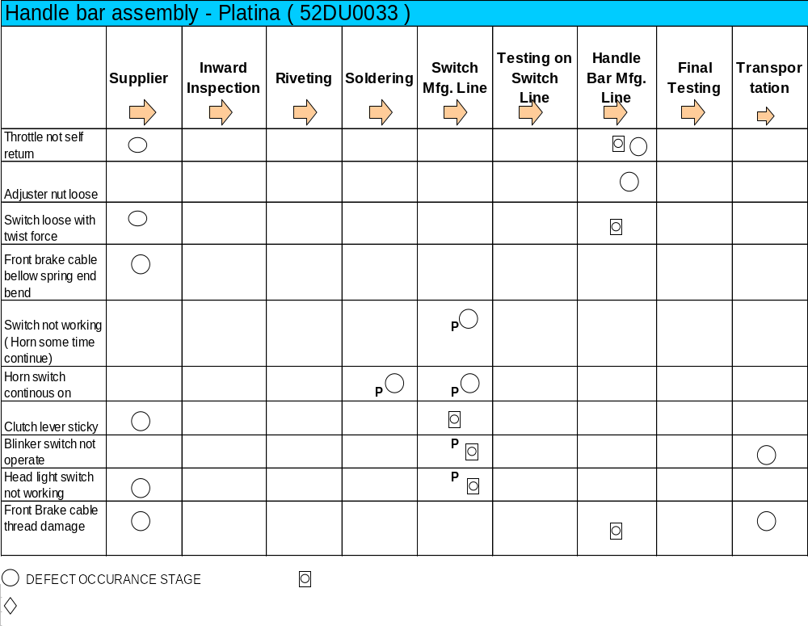
QA Matrix

Slide 22
Step-3 – Survey and analysis of 4M conditions
This analysis is a set of conditions with respect to Man, machine, material and method for obtaining a good products. It helps in identifying 4M standards and checking is possible against these standards. Removing this variability can some times eliminate Quality defects in the product.

Slide 23
Quality Defect factors -4M
Caused by Raw
Material conditions
Caused by Equipment
precision
Caused by Method
Conditions
Caused by Condition of
people involved
Producing materials
not generate defect
Manufacturing equipment
not generate defects
Devising methods
not generate defects
Fostering operators strong
in equipment and job
Search for materials
not generate defects
Manufacturing Equipment
not generate defects
Search for Methods
not generate defects
Autonomous maintenance & skill Education training
Fostering vendors
not cause defects
Improvements to
Equipment not generate
defects
Improvements to
Methods not generate
defects
PM
Analysis
Set condition of
material not to
generate defect
Set Conditions of
equipment not generate
defects
Set Condition of method
not generate defects
Trouble finding
Management of conditions
not generate defects
Pursue relationship
Between Quality Char &
Material / Equipment
Method conditions
Process and recovery
Zero Quality Defect
Maintenance & mgt

Slide 24
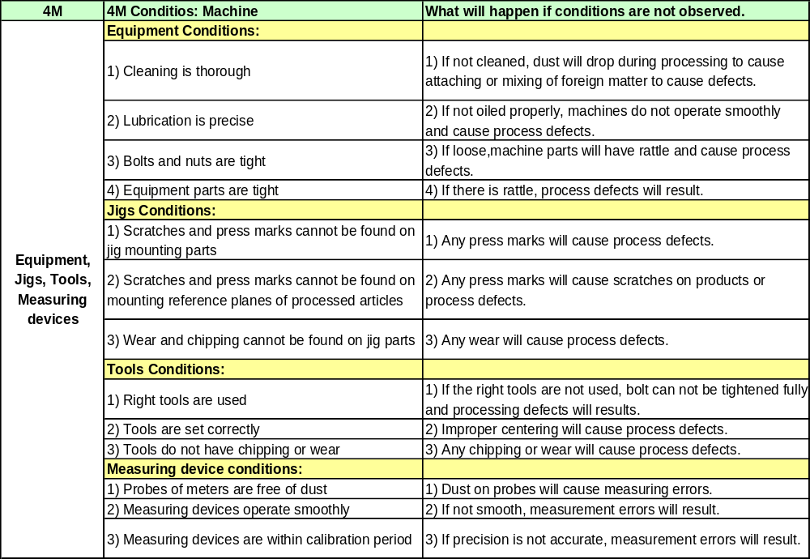
4M Condition to decide Quality

Slide 25
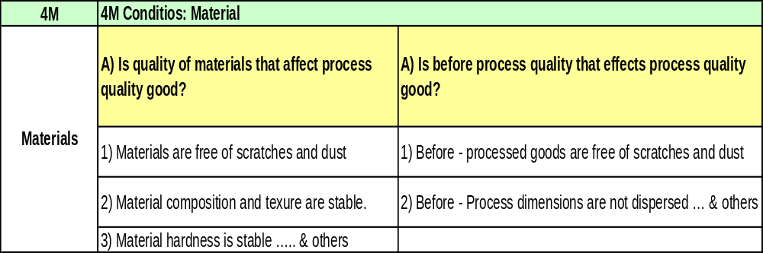
4M Condition to decide Quality

Slide 26
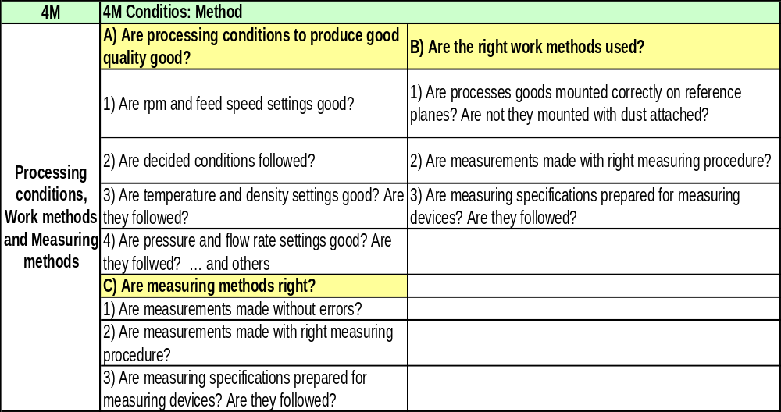
4M Condition to decide Quality

Slide 27
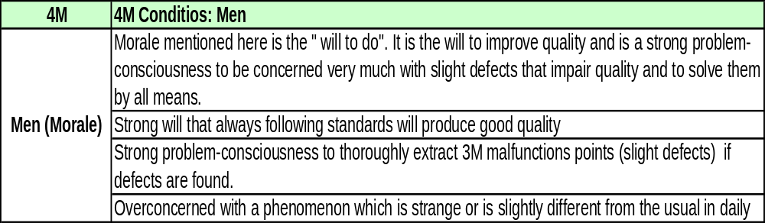
4M Condition to decide Quality

Slide 28
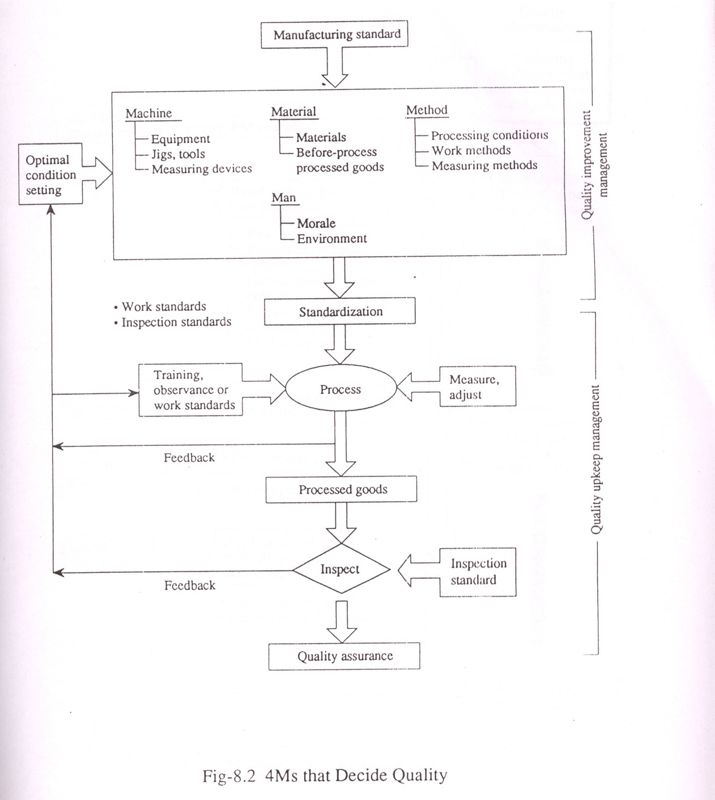
4M Condition to decide Quality

Slide 29
Step-4 – Study of malfunction countermeasures & restore malfunctions.
Corrective action (Kaizen / Pokayoke) for the defect phenomena.
Refer QA Matrix prepared earlier.
Consider all 4M conditions for the defect.
Analyze the defect & implement countermeasures for the root cause and possible causes.

Slide 30
Pokayoke for eliminating defects
Poka yoke is a technique for avoiding simple human errors at work.
Poka is a Japanese word meaning “Inadvertent error” and Yoke comes from Japanese word Yokerie meaning “to avoid”.
This has been termed as “Mistake / Fool Proofing”.

Slide 31
Pokayoke for eliminating defects
ERROR ARE INEVITABLE BUT CAN BE ELIMINATED
People always make mistakes. These can be reduced or even eliminated. Some of the Poka-Yoke devices, which can help to avoid defects are:
Guide Pins / Locators of different sizes
Error Detection Buzzers & Alarms
Limit Switches, Proximity & Photo sensors
Counters
Checklists

Slide 32
Basic classification of Poka yoke
PREDICTION V/s DETECTION
ALARM V/s SHOTDOWN Vs CONTROL
CONTACT V/s FIXED VALUE V/s MOTION READING METHODS

Slide 33
Pokayoke for eliminating defects
A. Prediction V/s Detection : When a Poka-Yoke is designed in a way that it helps the operator to recognise the defect before it is about to occur, it is called a Prevention or Prediction type Poka-Yoke.
When a Poka-Yoke helps the operator to know immediately on the occurrence of the defect then it is called Detection type Poka-Yoke.
Detection is “after” the defect is produced. The merit of this type of Poka-Yoke is based on the stage at which the defect is detected.

Slide 34
Pokayoke
Example : Prediction or Prevention :
A
B
Pins
Figure A shows that holes are wrongly drilled due to incorrect positioning of plate.
Figure B shows that incorrect positioning of plate is prevented by locating 4 reference pins.

Slide 35
Pokayoke
Example : Detection
A
B
Pins
Figure A shows that plate with 4 holes drilled is to be dispatched to the customer. Customer complaints show many plates with 3 holes drilled.
Figure B shows that mistake of less drilled holes is detected through a check by using 4 locator pins on a gauge.

Slide 36
Pokayoke for eliminating defects
Alarm V/s Shutdown V/s Control :
Alarm : Signals in form of buzzers, blinking lights are to warn when an abnormality, has occurred (defect) / about to occur (predict)
Shutdown : Normal function of machine or process is stopped when defect predicted / detected.
Control :
In Prevention type Poka-Yoke : control means that even intentional errors are impossible or methods by which the cause of defect if starts happening, it is automatically prevented from happening (feedback mechanism)
In Detection type Poka-Yoke : Control means that the process is not stopped but the defective items are automatically separated out & are not allowed to pass on to next stage.

Slide 37
Pokayoke for eliminating defects
Contact V/s Fixed Value V/s Motion Reading Methods for Poka-Yoke classification :
These use the principle of physical or energy contact with the product using sensing devices. They range from guide pins, limit switches, photo electric beams, etc.
Contact methods often take advantage of parts that are designed with an uneven shape. We can use guide pins or blocks that don’t allow the product to be seated in a machines jig in the wrong position.

Slide 38
Pokayoke
Example : Contact V/s Fixed Value V/s Motion Reading Methods for Poka-Yoke classification
PRESS
PRESS
Product
Product
Product
JIG
JIG
CORRECT
INCORRECT
JIG
Before : The sheet Metal part could be placed incorrectly during forming operation
After : Limit switch turns the machine on only when the protruding neck is positioned where it is supposed to be.

Slide 39
Pokayoke for eliminating defects
Type of sensing Devices :
Limit switches, Micro switches
Proximity switches
Photoelectric switches
Beam sensors
Sensor to detect changes in physical condition like temperature, pressure etc. (Pressure switches, thermostats etc.)

Slide 40
POKA-YOKE SHEET
Varroc Engineering Pvt Ltd.
Problem :
Prevent Error
Prevent Error
Solution :
Control
Key Improvement :
Detect Error
Alarm
BEFORE
AFTER
Sustenance Plan :

Slide 41
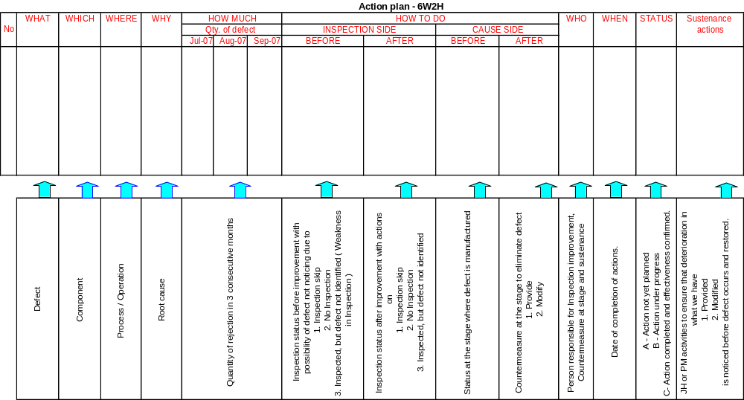
6W2H Format

Slide 42
Step-5 – Analyze conditions for non defective units that are not confirmed.
Study of other possible reasons for a defect, PM Analysis in some cases.
Find out conditions / control items from actual defects & possibility study for contributing non defective units.

Slide 43
Execution of PM Analysis for exposure and handling of malfunctions
PM Analysis is one of the most effective techniques to handle B types of defects. PM denotes (P) Physical phenomena (M) Mechanism. In this analysis we try to establish the relationship between phenomena and the physical mechanism behind it which explain the contributing conditions to cause such physical mechanisms.
These contributing conditions are then elaborated in terms of relationship with primary (man, material, machine, method) conditions. Usually these primary conditions are not measurable so they are once again converted into secondary conditions that can usually be physically inspected against a standard.

Slide 44
Step-6 – Improve 4M Condition defect
Step-7 – Setting 4M conditions
Survey, analysis & implementation of 4M conditions for possible and happened defects.
Carry out possibility study, identify all 4M conditions to ensure that defect does not occur.

Slide 45
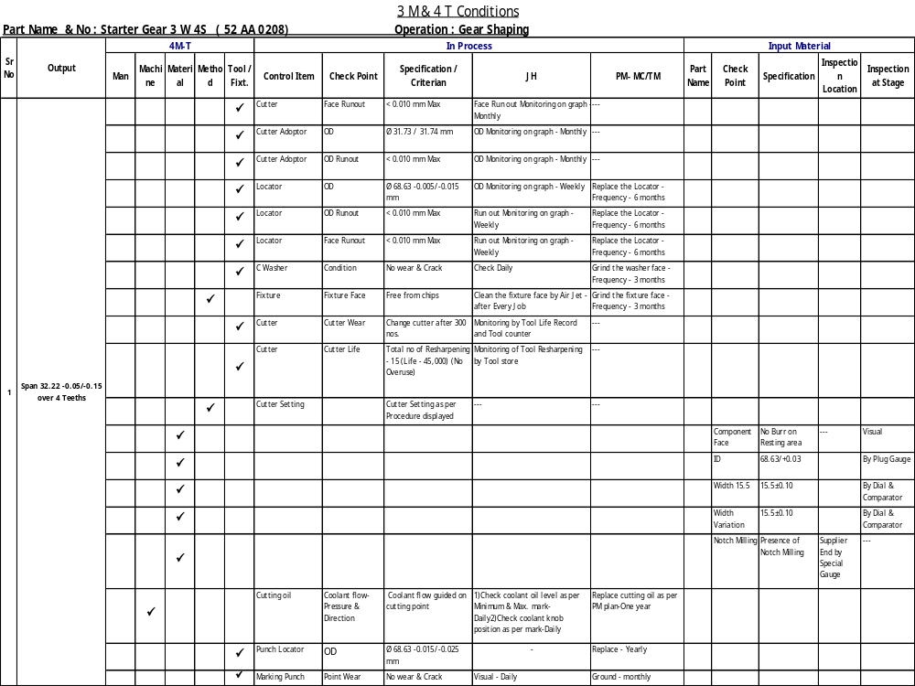
4 M & T Condition

Slide 46
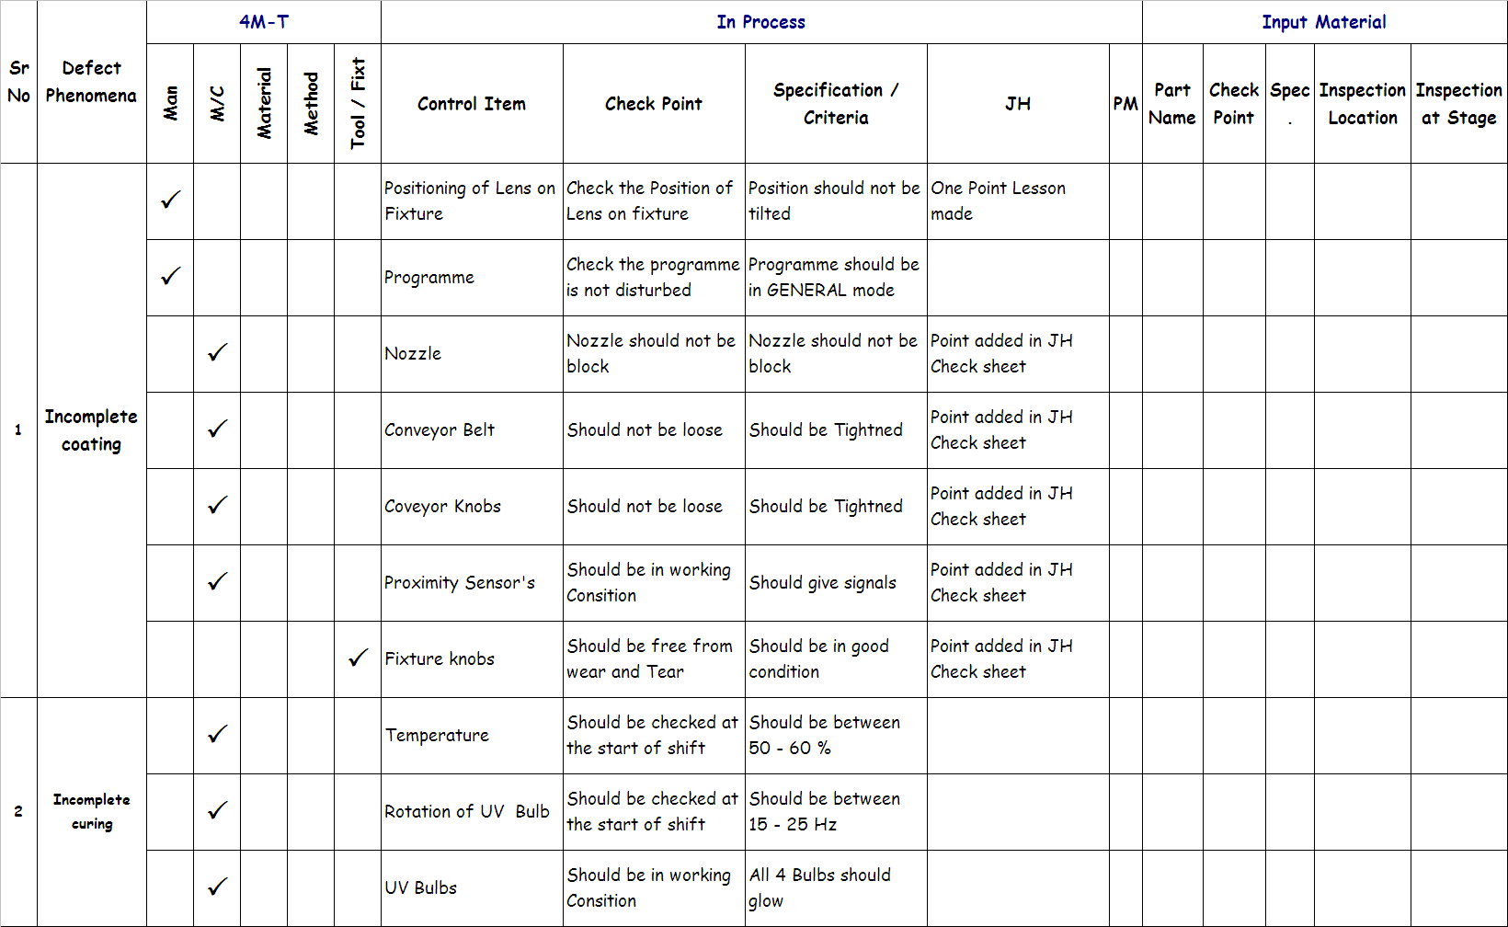
QM MATRIX - SUSTENANCE

Slide 47
Step-8 – Intensification & improvement of checking method
Review 4M conditions set before and after actions implementation.

Slide 48
Step-9 – Deciding check standard value
Step-10 – Revise standards
Review QM Matrix for control items identified to produce non defective items
Prepare inspection manual for control items, to simplify inspection activity
Introduce control items as check points in JH, PM check sheets for effective monitoring.

Slide 49
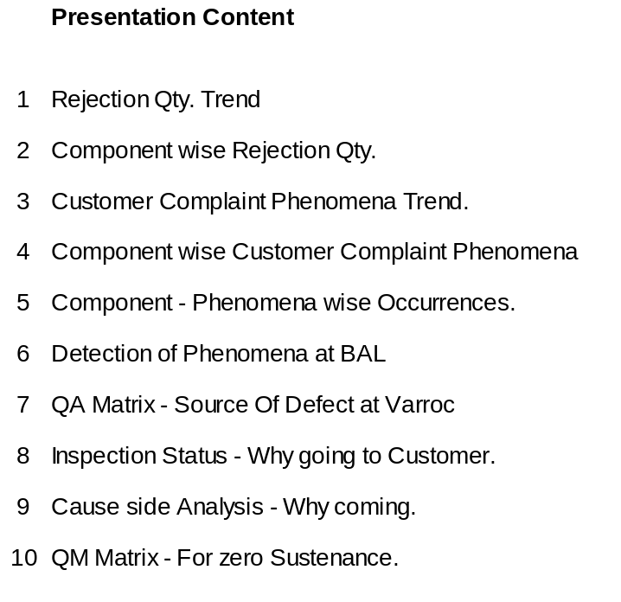
QOQM 10 STEP APPROACH

Slide 50
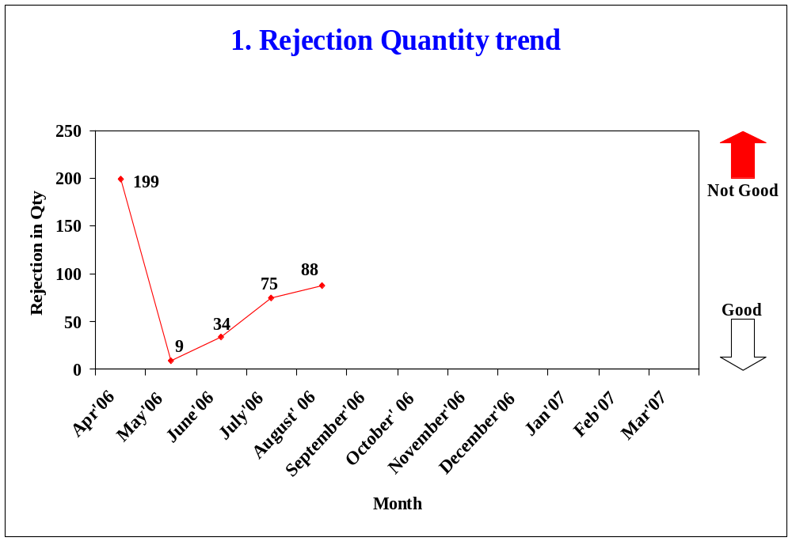
Target - Zero

Slide 51
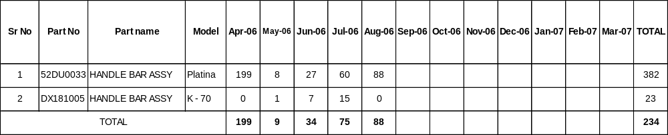
2. Component wise rejection Quantity
=> Total components being supplying : Two Nos
=> Components having above Zero PPM : One Nos
=> Components having Zero PPM : One Nos

Slide 52
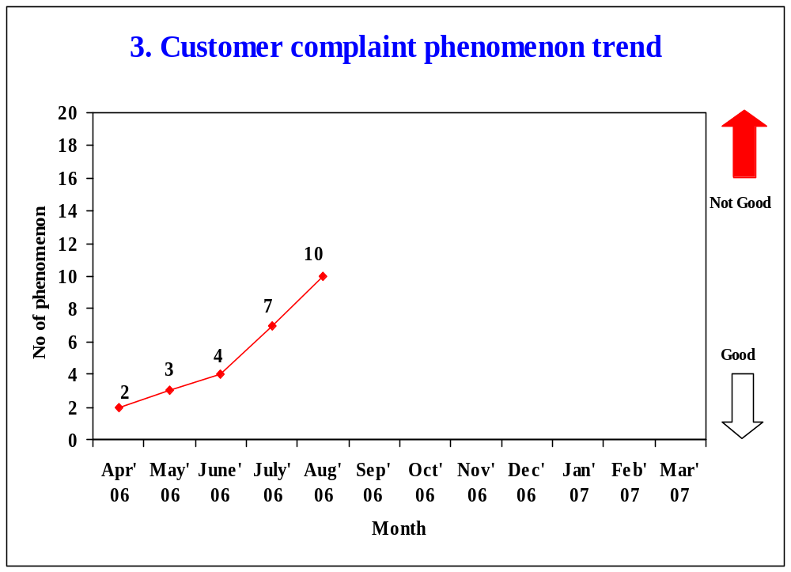
Target - Zero

Slide 53
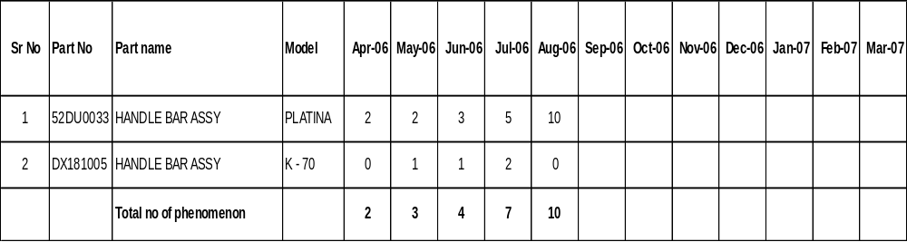
4. Component wise customer complaint phenomenon

Slide 54
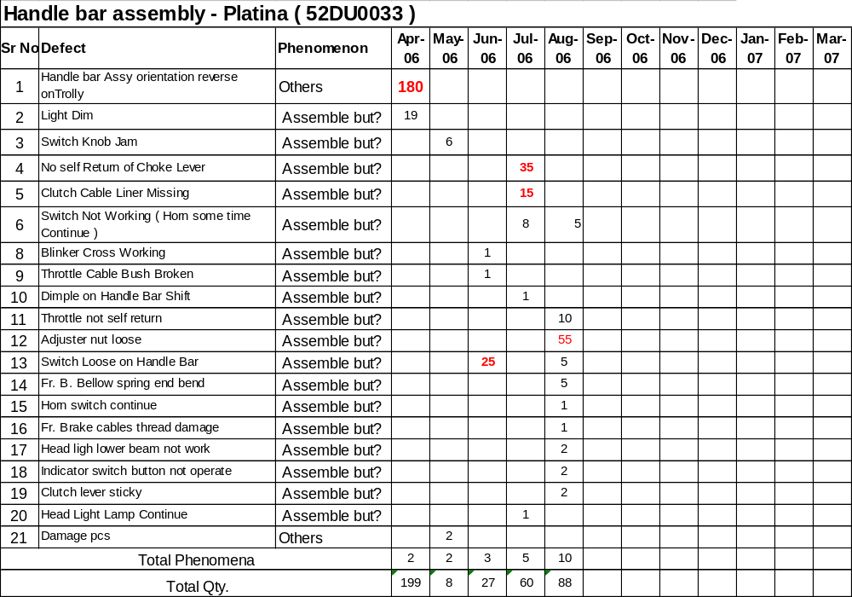
5. Component – phenomenon wise occurrences

Slide 55
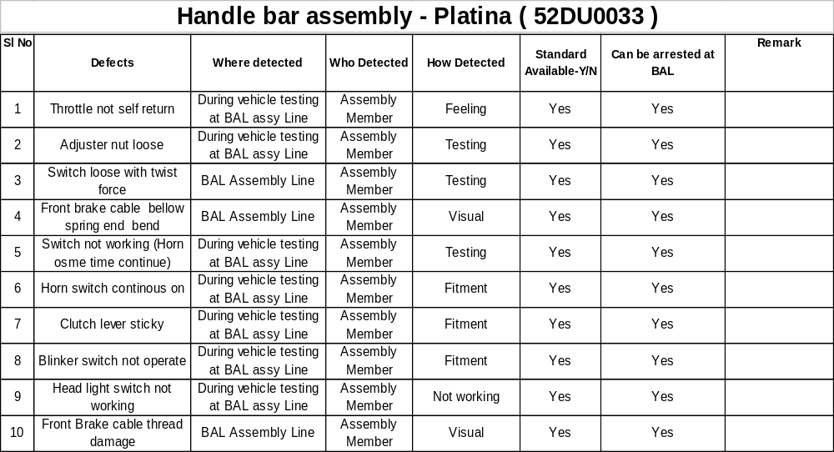
6. Detection of physical phenomenon at BAL

Slide 56
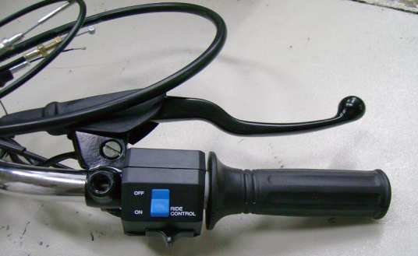
Defects detail Platina ( 52 DU0033 )
Problem –Throttle not Self Return

Slide 57
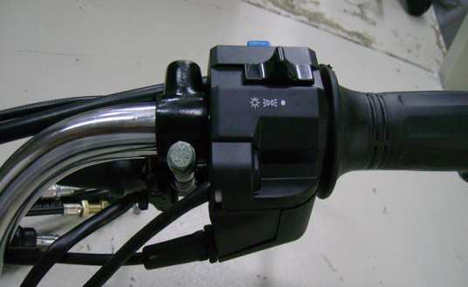
Defects detail Platina ( 52 DU0033 )
Problem – Adjuster nut loose in Accelerator cable

Slide 58
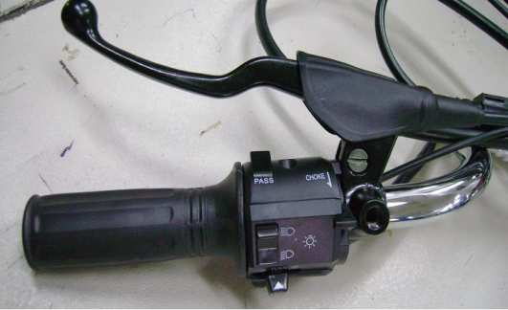
Defects detail Platina ( 52 DU0033 )
Problem – Switch Loose with Twist Force

Slide 59
Defects detail Platina ( 52 DU0033 )
Problem – Clutch movement sticky

Slide 60
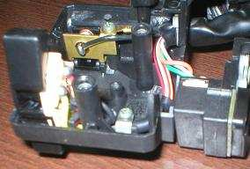
Defects detail Platina ( 52 DU0033 )
Problem – Horn short / continuous on
Wire pressed between metalic base & terminal

Slide 61
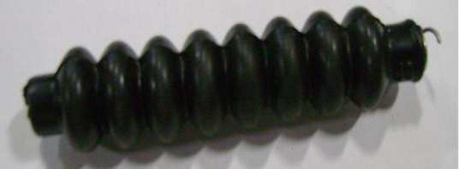
Defects detail Platina ( 52 DU0033 )
Problem – Front Brake Cable Bellow Spring Bend

Slide 62
7. QA Matrix – Source of Defects at Varroc

Slide 63
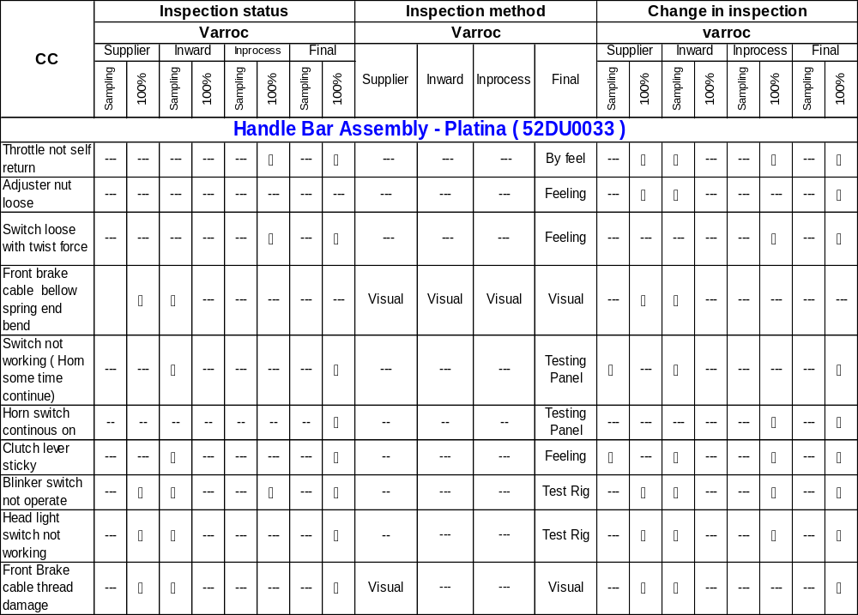
8. Inspection status - Why going to customer

Slide 64
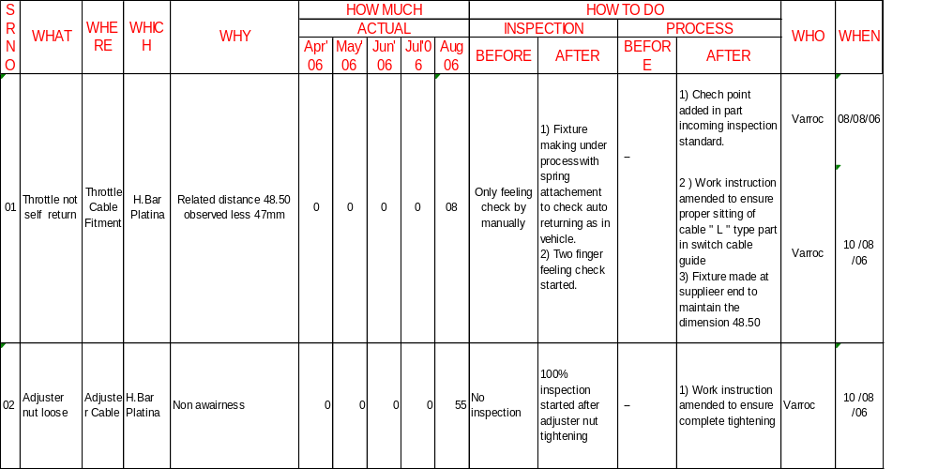
9.Cause side analysis – Why coming
6W 2H –CUSTOMER COMPLAINTS – Handle bar Assembly – Platina ( 52DU0033 )

Slide 65
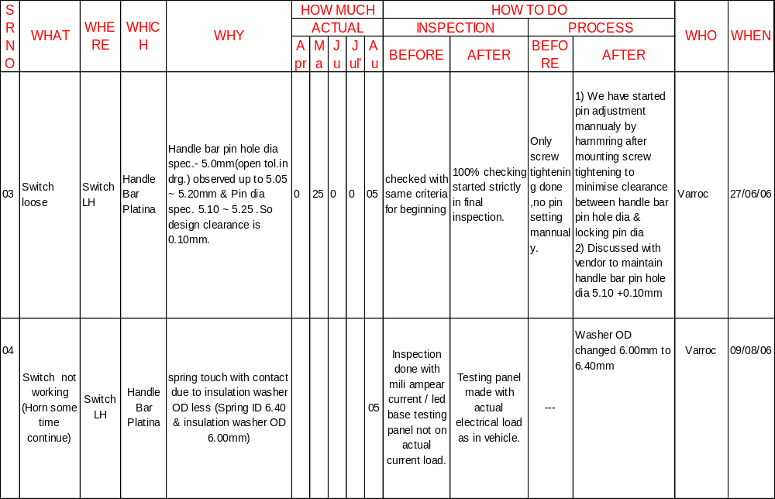
9.Cause side analysis – Why coming
6W 2H –CUSTOMER COMPLAINTS – Handle bar Assembly – Platina ( 52DU0033 )

Slide 66
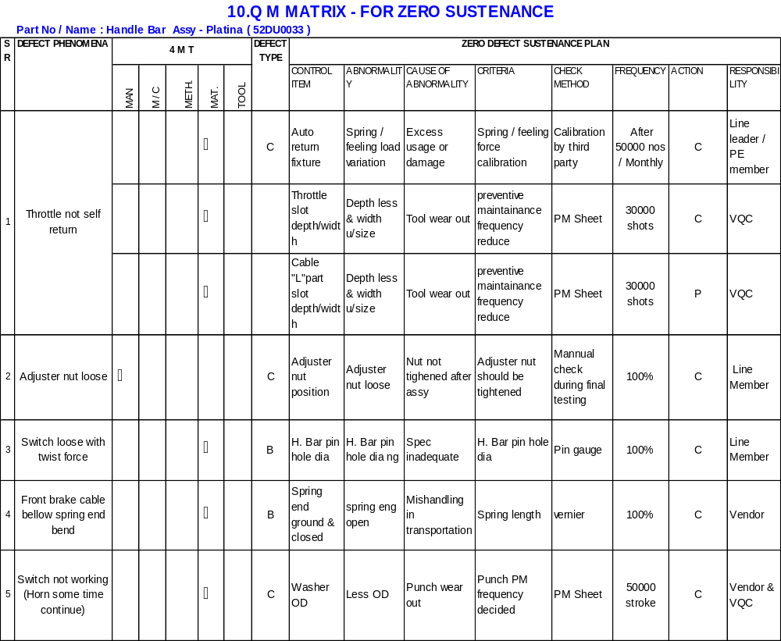

Slide 67
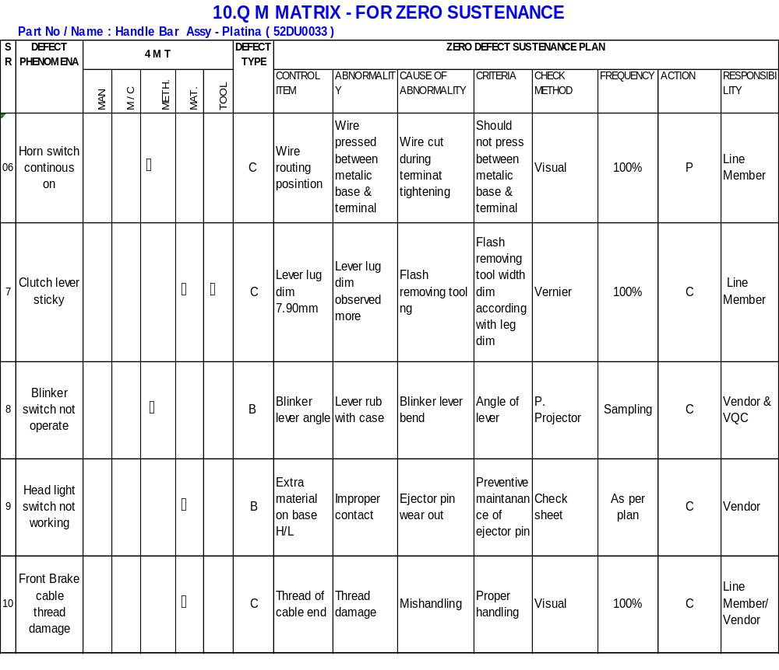

Slide 68
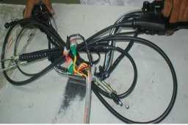
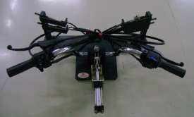
Customer Complaint – Change In Inspection Method
Customer Complaint :- Throttle not self return
Before
After
Spring attachement provided as in vehicle to check auto returning of Accelrator ,Levers &choke lever
Only feeling check
Spring attachement provided as in vehicle to check auto returning of Accelrator & levers

Slide 69
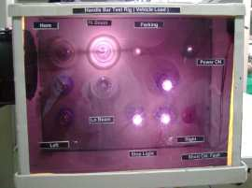
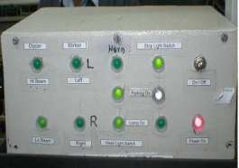
Customer Complaint – Change In Inspection Method
Customer Complaint :- Continuity short / no continuity in Switch modules
Before
After
LED Base Testing Pannel
Testing Pannel made with actual electrical load as in vehicle

Slide 70
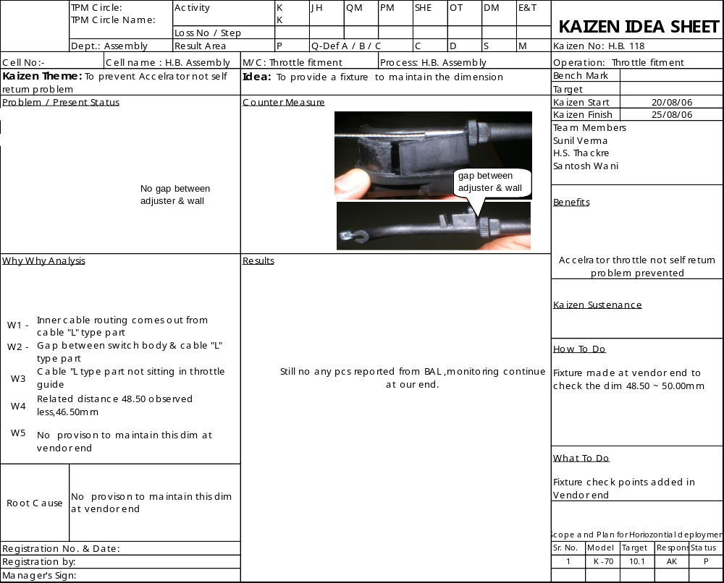

48.50 ~50mm
Fixture

Slide 71
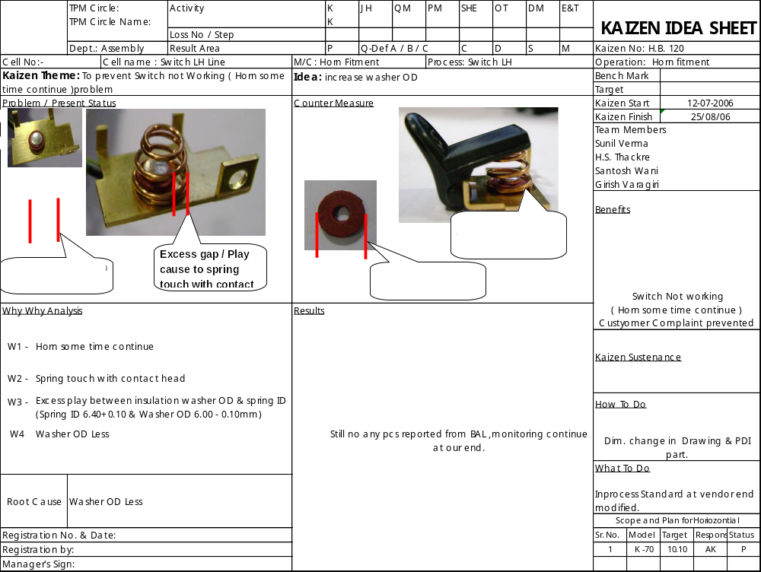

Slide 72
Cost of Quality

Slide 73
Cost of Quality
Quality Cost
Conformance
Non-Conformance
Prevention
Appraisal
Internal failure
External failure
Expenditure on :
Rework.
Scrap.
Expenditure on cost of:
Training.
Establishing procedures
Planning activities.
Analysis of performance for improvement..
Expenditure on :
Activities like checking.
Inspection work.
Conducting audits

Slide 74
Relationship between the pillars of TPM activities and Quality maintenance
KK
PM ANALYSIS
Quality Maintenance
KAIZENS
JH
7 STEPS OF JH
EQUIPMENT: NOT PRODUCING QUALITYDEFECT
* DAILY INSPECTION
SETTING OF CONDITIONS (Decide Rightly)
Application of
PM
Equipment diagnosis
CONDITION MANAGEMENT (Follow Strictly)
Technology
Feedback
DM
MP DESIGN
Fostering proficiency
of Employee in
Equipment operation
& maintenance
E & T
ACCOMPLISH
ZERO DEFECTS

Slide 75
THANK YOU

